Slide 1
Behavioral pharmacology basics
Lecture 4

Slide 2
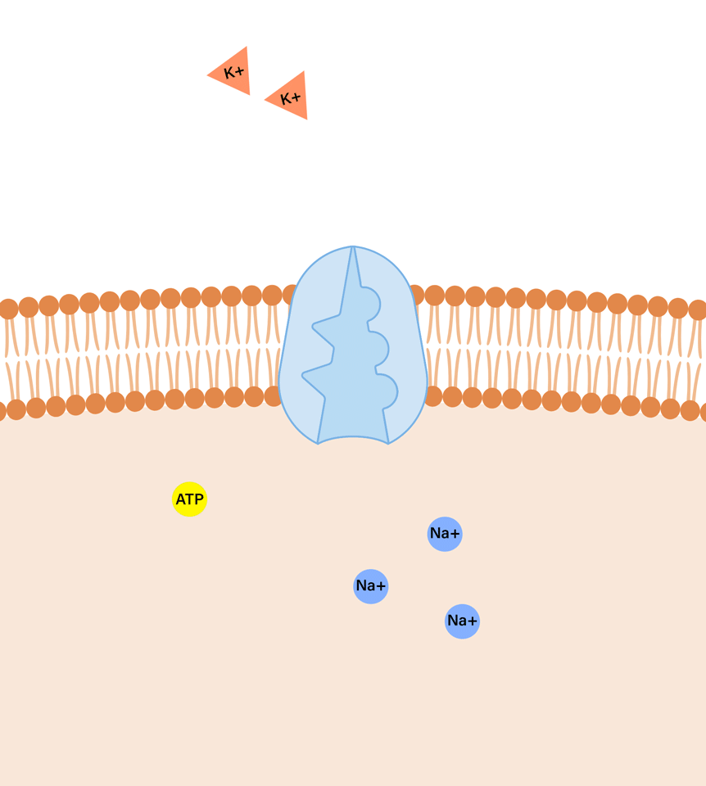
(NA+) / (K+ ) Sodium Potassium Pump
One thing to add to Lecture 3 ***
A sodium-potassium pump is an enzyme found in the membrane of most neurons.
It is a way to transport sodium and potassium ions across the cell membrane, against their concentration gradient (low to high concentration), resetting the membrane potential back to its hyperpolarized state
Notes:
an video to review neurotransmission, but note the timestamps, as we aren’t really going into electrical synapses in this class (4:37-7:50) :
https://www.youtube.com/watch?v=VitFvNvRIIY

Slide 3
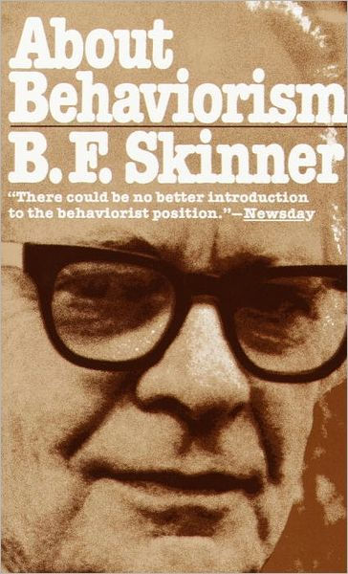
Behavioral Pharmacology Basics
How do behavioral pharmacologists classify drugs?
By their behavioral effects
By their effects on the brain
By their chemical composition

Slide 4
6 primary psychoactive Drug classes
1) Psychostimulants - produce wakefulness and a sense of energy and well-being.
2) Depressants - slow nervous system activity.
3) Opioids - produce a relaxed, dreamlike state.
4) Psychedelics (Hallucinogens)- produce perceptual and emotional changes.
5) Psychotherapeutics - prescribed to treat symptoms of mental disorders.
6) Cannabinoids – produce feelings of relaxation and psychoactive mood changes.
Notes:
by psychiatrists/physicians etc

Slide 5
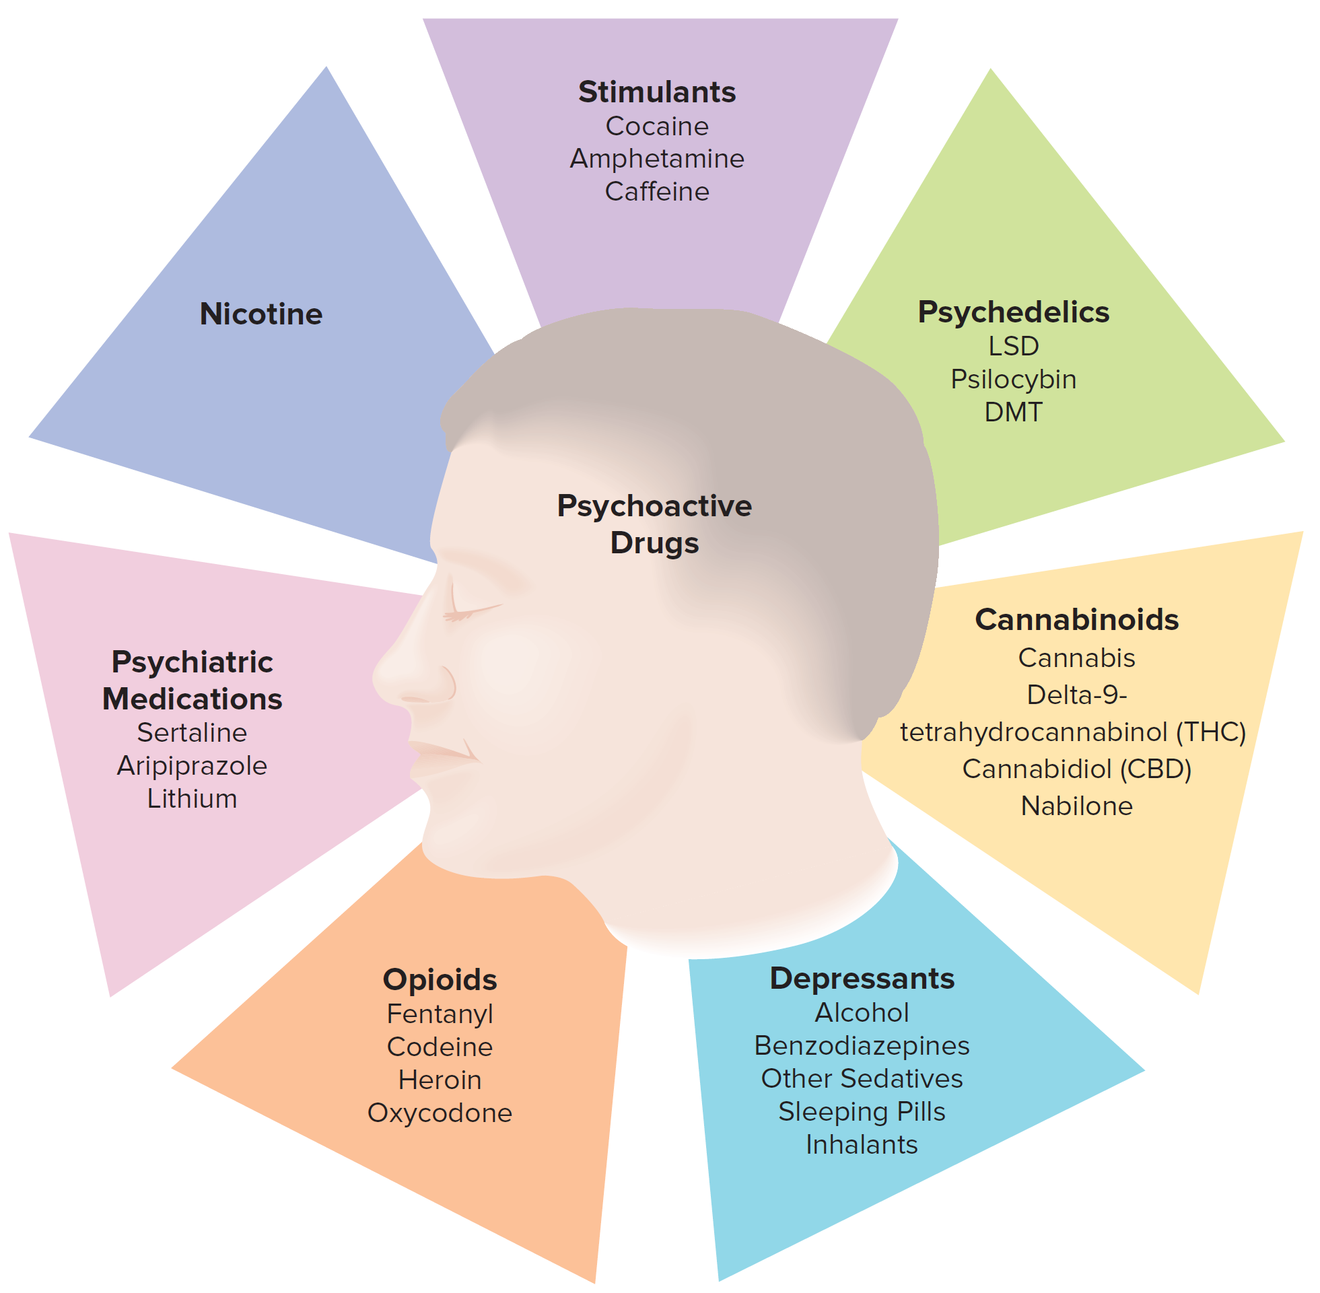
Figure 5.1: Classification of Psychoactive Drugs
*
*
Some drugs belong to multiple categories.
Examples: Cannabis and nicotine.
Notes:
As with any classification system, some things don’t seem to fit into the classes. Nicotine and cannabis are two such drugs.

Slide 6
FYI - NOT technically Drug classes – related terms
Narcotic
Sedative
Tranquilizer
Analgesic
Anesthetic
Anxiolytic
Euphoric
Rewarding
Reinforcing

Slide 7
Names of Drugs
Chemical name.
Gives a complete chemical description of the molecule.
Derived from the rules of organic chemistry for naming any compound.
Street name.

Slide 8
Names of Drugs
Brand/Trade name.
Specific formulation trademarked by manufacturers.
Patented drugs can be manufactured and sold for 20 years without direct competition by the companies that discovered and patented them.
Example: Concerta, or methylphenidate.
Generic name.
Official or legal name of drugs.
Listed in the United States Pharmacopeia, or USP.
Cannot be trademarked.

Slide 9
Chemical | Generic | Trade | Street
3,4-methylenedioxy-N-methylamphetamine | Methylenedioxymetham-phetamine (MDMA) | ------ | Ecstasy, Molly
N-methyl-1-phenylpropan-2-amine | Methamphetamine | Desoxyn | Meth, Crystal, Ice,
(5α,6α)-7,8-didehydro-4,5-epoxy-17-methylmorphinan-3,6-diol diacetate | diamorphine | Heroin | H, Junk, Dope, Black Tar
1-phenylpropan-2-amine | D-amphetamine | Adderall, Dexedrine | Speed
N-acetyl-para-aminophenol | acetaminophen, paracetamol | Tylenol | ??
4,5a-Epoxy-3-methoxy-17-methylmorphinan-6-one | Hydrocodone | Vicodin | Vikes
1-(1-)phenylcyclohexyl)-piperidine | phencyclidine | Sernyl | PCP, Angel Dust, Love Boat
(6aR,9R)- N,N- diethyl- 7-methyl- 4,6,6a,7,8,9- hexahydroindolo- [4,3-fg] quinoline- 9-carboxamide | Lysergic Acid | Delsyd | LSD, Acid
Notes:
This is all FYI…for now ☺

Slide 10
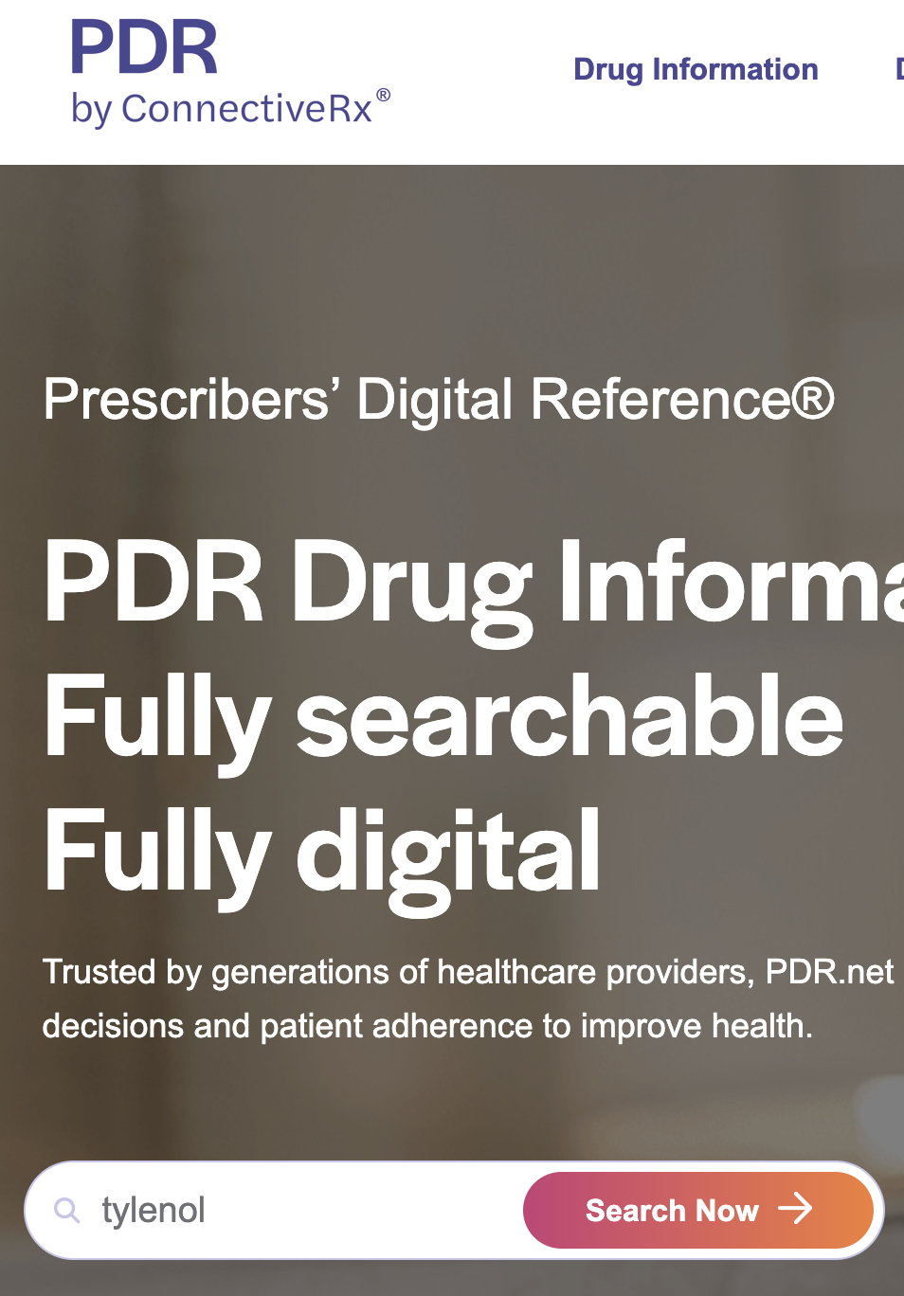
Drug Identification
https://www.pdr.net/
Physicians can tell from appearance of the drug the exact drug and dose.
The Physician’s Desk Reference, or PDR, includes color photographs of legally manufactured pharmaceuticals.
Illegal drugs are sometimes marked, packaged, or labeled in an identifiable way.
Drugs can also be tested and identified through chemical analyses.

Slide 11
Pharmacodynamics - Mechanisms of Drug Action
Pharmacodynamics – the mechanisms by which a drug exerts its effects on the body
Drugs may affect neurons by…
…. altering the electrical characteristics of the neuron.
… changing the availability of a neurotransmitter by shifting the transmitter chemical’s rate of:
Synthesis.
Release from storage vesicles.
Reuptake into the releasing neuron.
Metabolism.
… activating (agonist) or preventing the activation (antagonist) specific neurotransmitter receptors.
Notes:
“How drugs work”

Slide 12
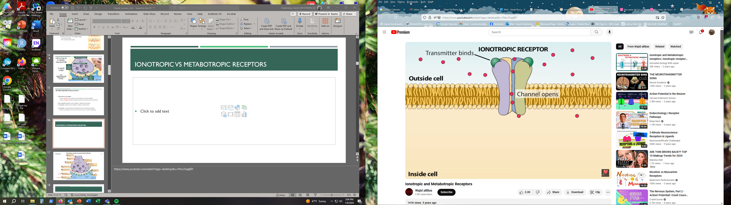
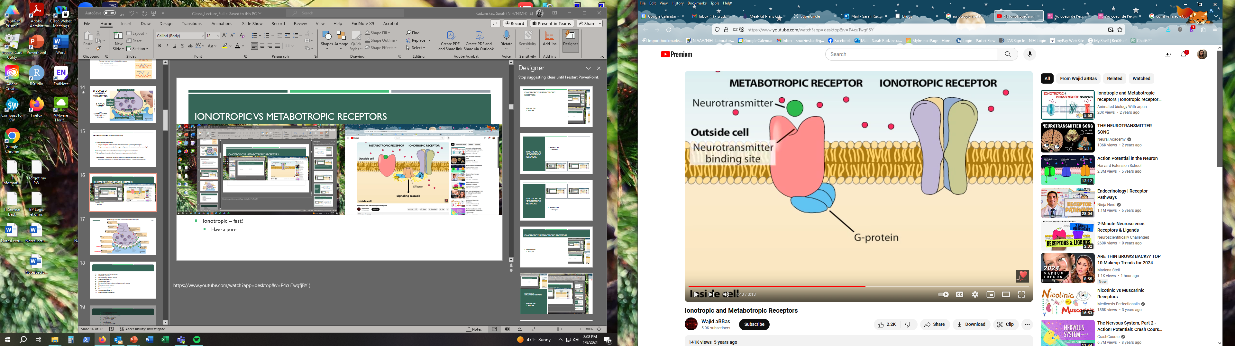
Pharmacodynamics: Receptor Subtypes Ionotropic vs metabotropic receptors
Ionotropic –
Fast (within a 1-2 milliseconds!)
Multimeter proteins that create a ion pore across the membrane
Metabotropic / “G-protein Coupled” –
‘slow’ (100 milliseconds – sometimes longer)
Have intracellular ‘G-proteins’ that are either stimulatory (G_{s} or G_{q}) or inhibitory (G_{i})
Notes:
More than you need to know, but for review if you’d like: https://www.youtube.com/watch?app=desktop&v=P4cuTwgfjBY

Slide 13
Pharmacodynamic effects
Not all effects observed are caused by the pharmacological actions of the drugs themselves.
Specific Effects
Pharmacological or chemical effects of drug on brain/body
Depend on the presence of a chemical at certain concentrations in the target tissue.
Nonspecific Effects
Effects not due to drug’s pharmacological actions on the brain/body
“Placebo effects” are generally, “good” non-specific effects
“Nocebo effects” are usually, “bad” non-specific effects

Slide 14
Studying Drugs Clinically: Balanced Placebo Design
Told
Nicotine Placebo
Group 1 | Group 3
Group 2 | Group 4
Nicotine
Given
Placebo

Slide 15
Due to both specific and non-specific effects
Due mainly to specific effects
Juliano et al., 2011

Slide 16
Studying Drugs Clinically: Double-Blind Procedure
Neither the experimental participants nor the researchers know whether a subject is receiving a placebo or an experimental drug.
The relevant individuals are informed about which participants comprised the drug conditions after the experiment is over.
In combination, experiments that control non-specific effects (e.g., balanced placebo experiments and double-blind experiments) are best methods to isolate specific effects AND test for the effectiveness of a new drug.

Slide 17
The “unblinding problem” in psychiatric research
Other Challenges in behavioural pharmacology
At the end of a trial, research subjects usually figure out which condition they are in. How?
1) Side effects.
Unintended effects that accompany specific therapeutic effects.
2) Expectancy Effects.
Derive from the user’s unique background and particular perception of the environment.

Slide 19
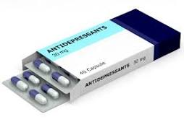
Expectancy and Nonspecific Drug Effects
They can be produced by an inactive OR active chemical that the user believes to be a drug.
Be careful… non-specific =/= side effects
Discussion:
Antidepressants - some researchers suggest that for many, their therapeutic benefits are largely due to non-specific effects…
https://www.youtube.com/watch?v=Zihdr36WVi4 (Start-7:15)

Slide 20
Distinguishing between specific and non-specific effects
Textbook says: “Perhaps the strongest demonstration of the specific effects of a drug is obtained when the dose of the drug is varied and the size of the effect changes directly with the drug dose.”
Why?
In the dose is the poison…

Slide 21
Drug effects and toxicity: How do we measure it?
Toxicity → the physical or psychological harm that a drug might present to the user
Dose-response curve - Graph depicting the relationship between the drug dose and the resulting drug effects.
Different dose-response curves can be created for different drug effects.
Some response systems have higher thresholds.
Some drugs have an all-or-none dose-response relationship.
Threshold - The lowest dose at which an effect is observed.

Slide 22
Anatomy of a Dose-Response curve
Dose
Amount of drug, goes on X-axis
Usually metric weights, i.e., grams (g), milligrams (mg), micrograms (mcg or “µg”)
Often adjust for bodyweight (e.g., “mg/kg”), but not always
Or metric volumes, e.g., liters, milliliters, etc.
Sometimes imperial units, e.g., ounces, pounds, pints, etc.

Slide 23
Anatomy of a Dose-Response curve
(…aka dose-effect curves)
Response or Effect
Goes on Y-axis
Drugs have multiple different effects, so always make sure to specify which one you’re talking about
E.g, analgesia, which could be operationally defined as latency to flick tail when under hot light
Response could be % of subjects showing some behavior
Or it could be the strength of a response measured
e.g., “how much do you like this drug on a scale of 1 to 7?”

Slide 24
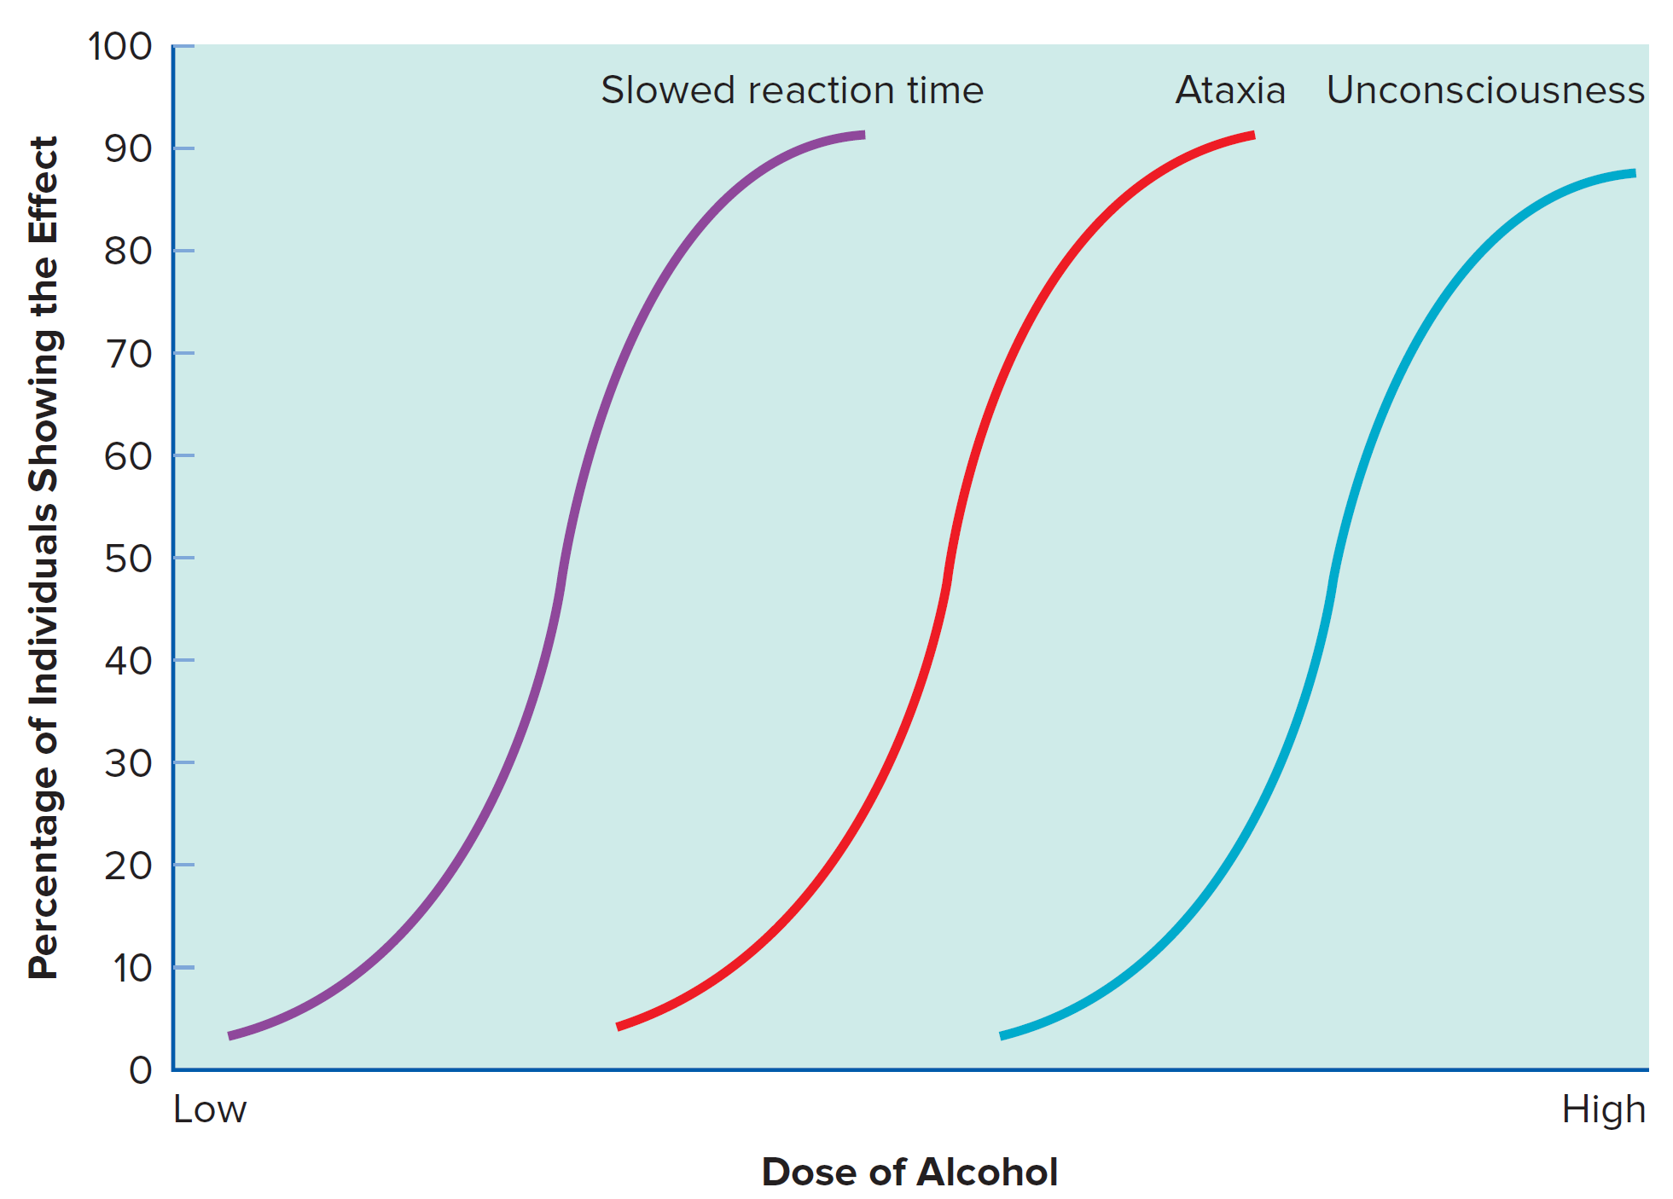
Figure 5.2: Relationship between Alcohol Dose and Multiple Responses

Slide 25
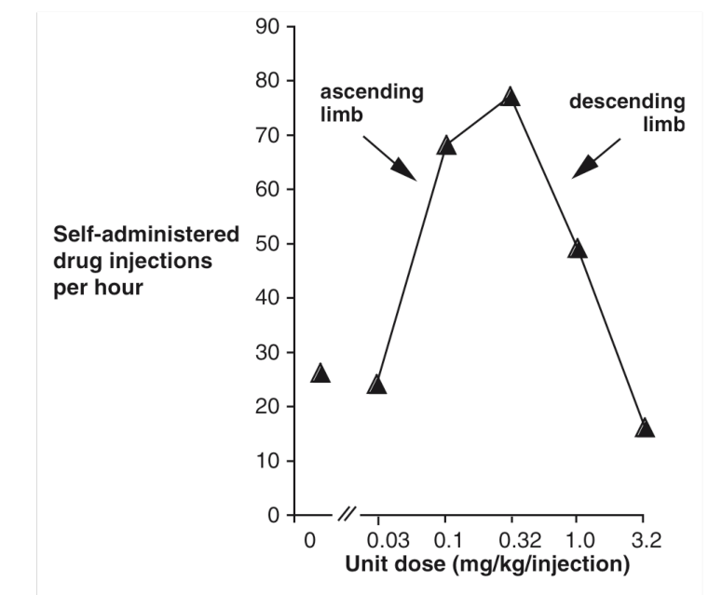
Examples: Other Dose-Response Curves

Slide 26
What can we learn from dose-response curves?
Median effective dose (ED₅₀)
Median lethal dose (LD₅₀)
Therapeutic index
Margin of safety
Potency
Efficacy

Slide 27
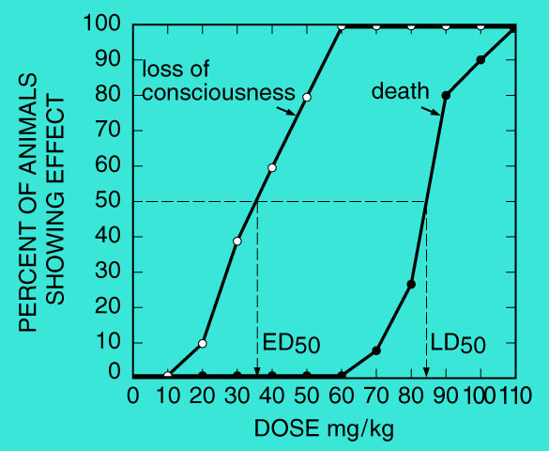
Effective dose, or ED.
Dose of a drug that produces a meaningful effect in some percentage of test subjects.
E D₅₀
ED₅₀ is an amount (g, mg, ounces, ml, etc).
Amount that produces effect (i.e., “effective dose”) in half of subjects
Amount that produces a half maximal effect.
What is the ED₉₅ for this example?

Slide 28
Lethal dose, or LD.
Dose of a drug that has a lethal effect in some percentage of test subjects.
L D₅₀ is the lethal dose for half (50%) of the subjects
Most drugs have an L D₁ well above the E D₉₅ level.
(yes, this graph shows a very dangerous drug)

Slide 29
Median Lethal Dose
Therapeutic Index, or tI.
Therapeutic Index = LD₅₀/ED₅₀
So, this is one amount divided by another amount
Should always be greater than one.

Slide 30
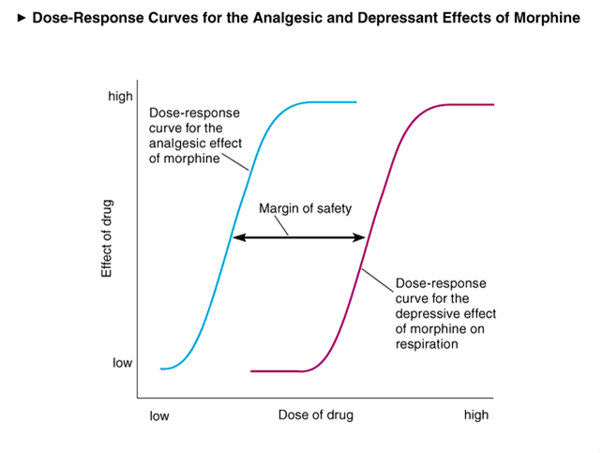
Margin of Safety
Margin of Safety
Safety margin.
dose producing unacceptable toxic minus dose that is effective in most people

Slide 31
Potency vs. Effectiveness
Potency and effectiveness
Effectiveness (or “Efficacy”): Maximum effect a drug can have at any dose
an inherent characteristic of the drug.
Potency: the amount of drug required to produce an effect.
Codeine < morphine < heroin < fentanyl

Slide 32
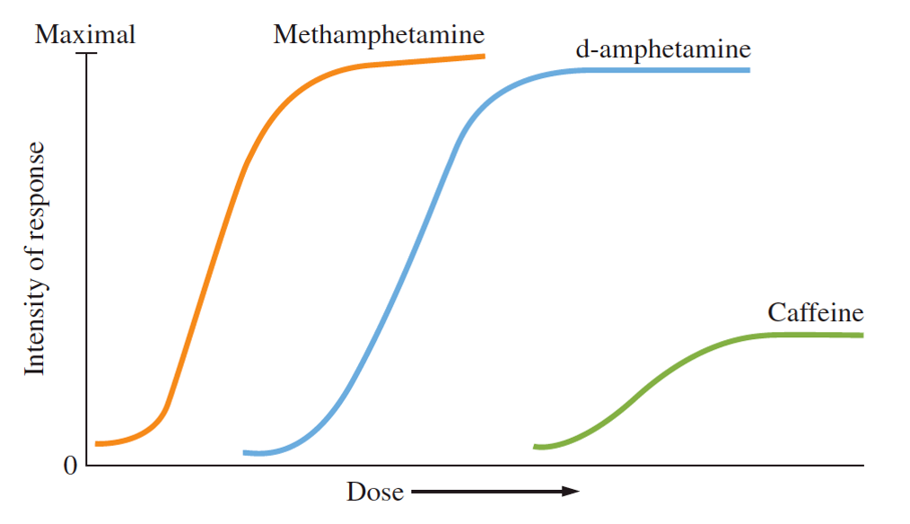
Let’s look at this for some stimulants…

Slide 33
What might a dose-response curve representing codeine and morphine look like? Presume Codeine’s ED₅₀ =100mg and morphine is ~6x more potent
% of subjects
obtaining
pain relief
Codeine
(remember to plot ED₅₀)
Notes:
Potency: Codeine < morphine < heroin < fentanyl

Slide 34
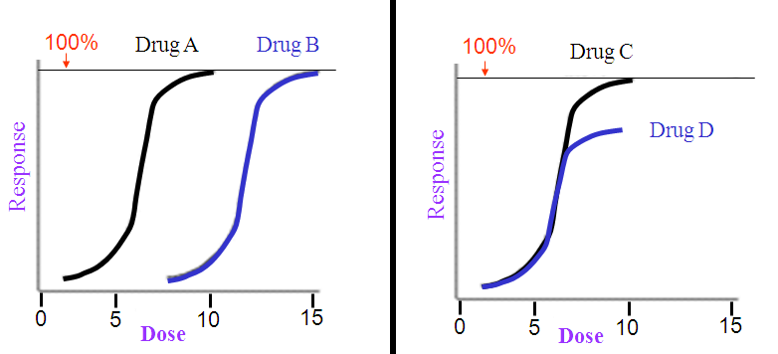
Potency vs. Effectiveness
Be careful - People confuse this often
These drugs differ in potency, but have same effectiveness
These drugs have the same potency, but differ in effectiveness

Slide 35
Pharmacokinetics
How the body handles/interacts with drugs
The time course of a drug’s effect depends on 3 major factors:
1) Absorption (how to get drug into blood)
Routes of administration
2) Distribution (of drug around body)
3) Metabolism (or Elimination)

Slide 36
ABSORPTION
/ ADMINISTRATION

Slide 37
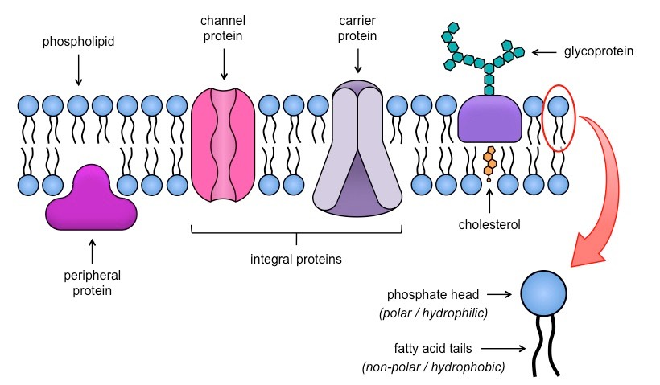
Absorption
Lipid solubility (extent to which a psychoactive drug dissolves in oils and fats) important at each stage:
To get into capillaries in body,
To get out of capillaries in the brain so that drug can act on neurons
Notes:
Dosage and pH also factor in

Slide 38
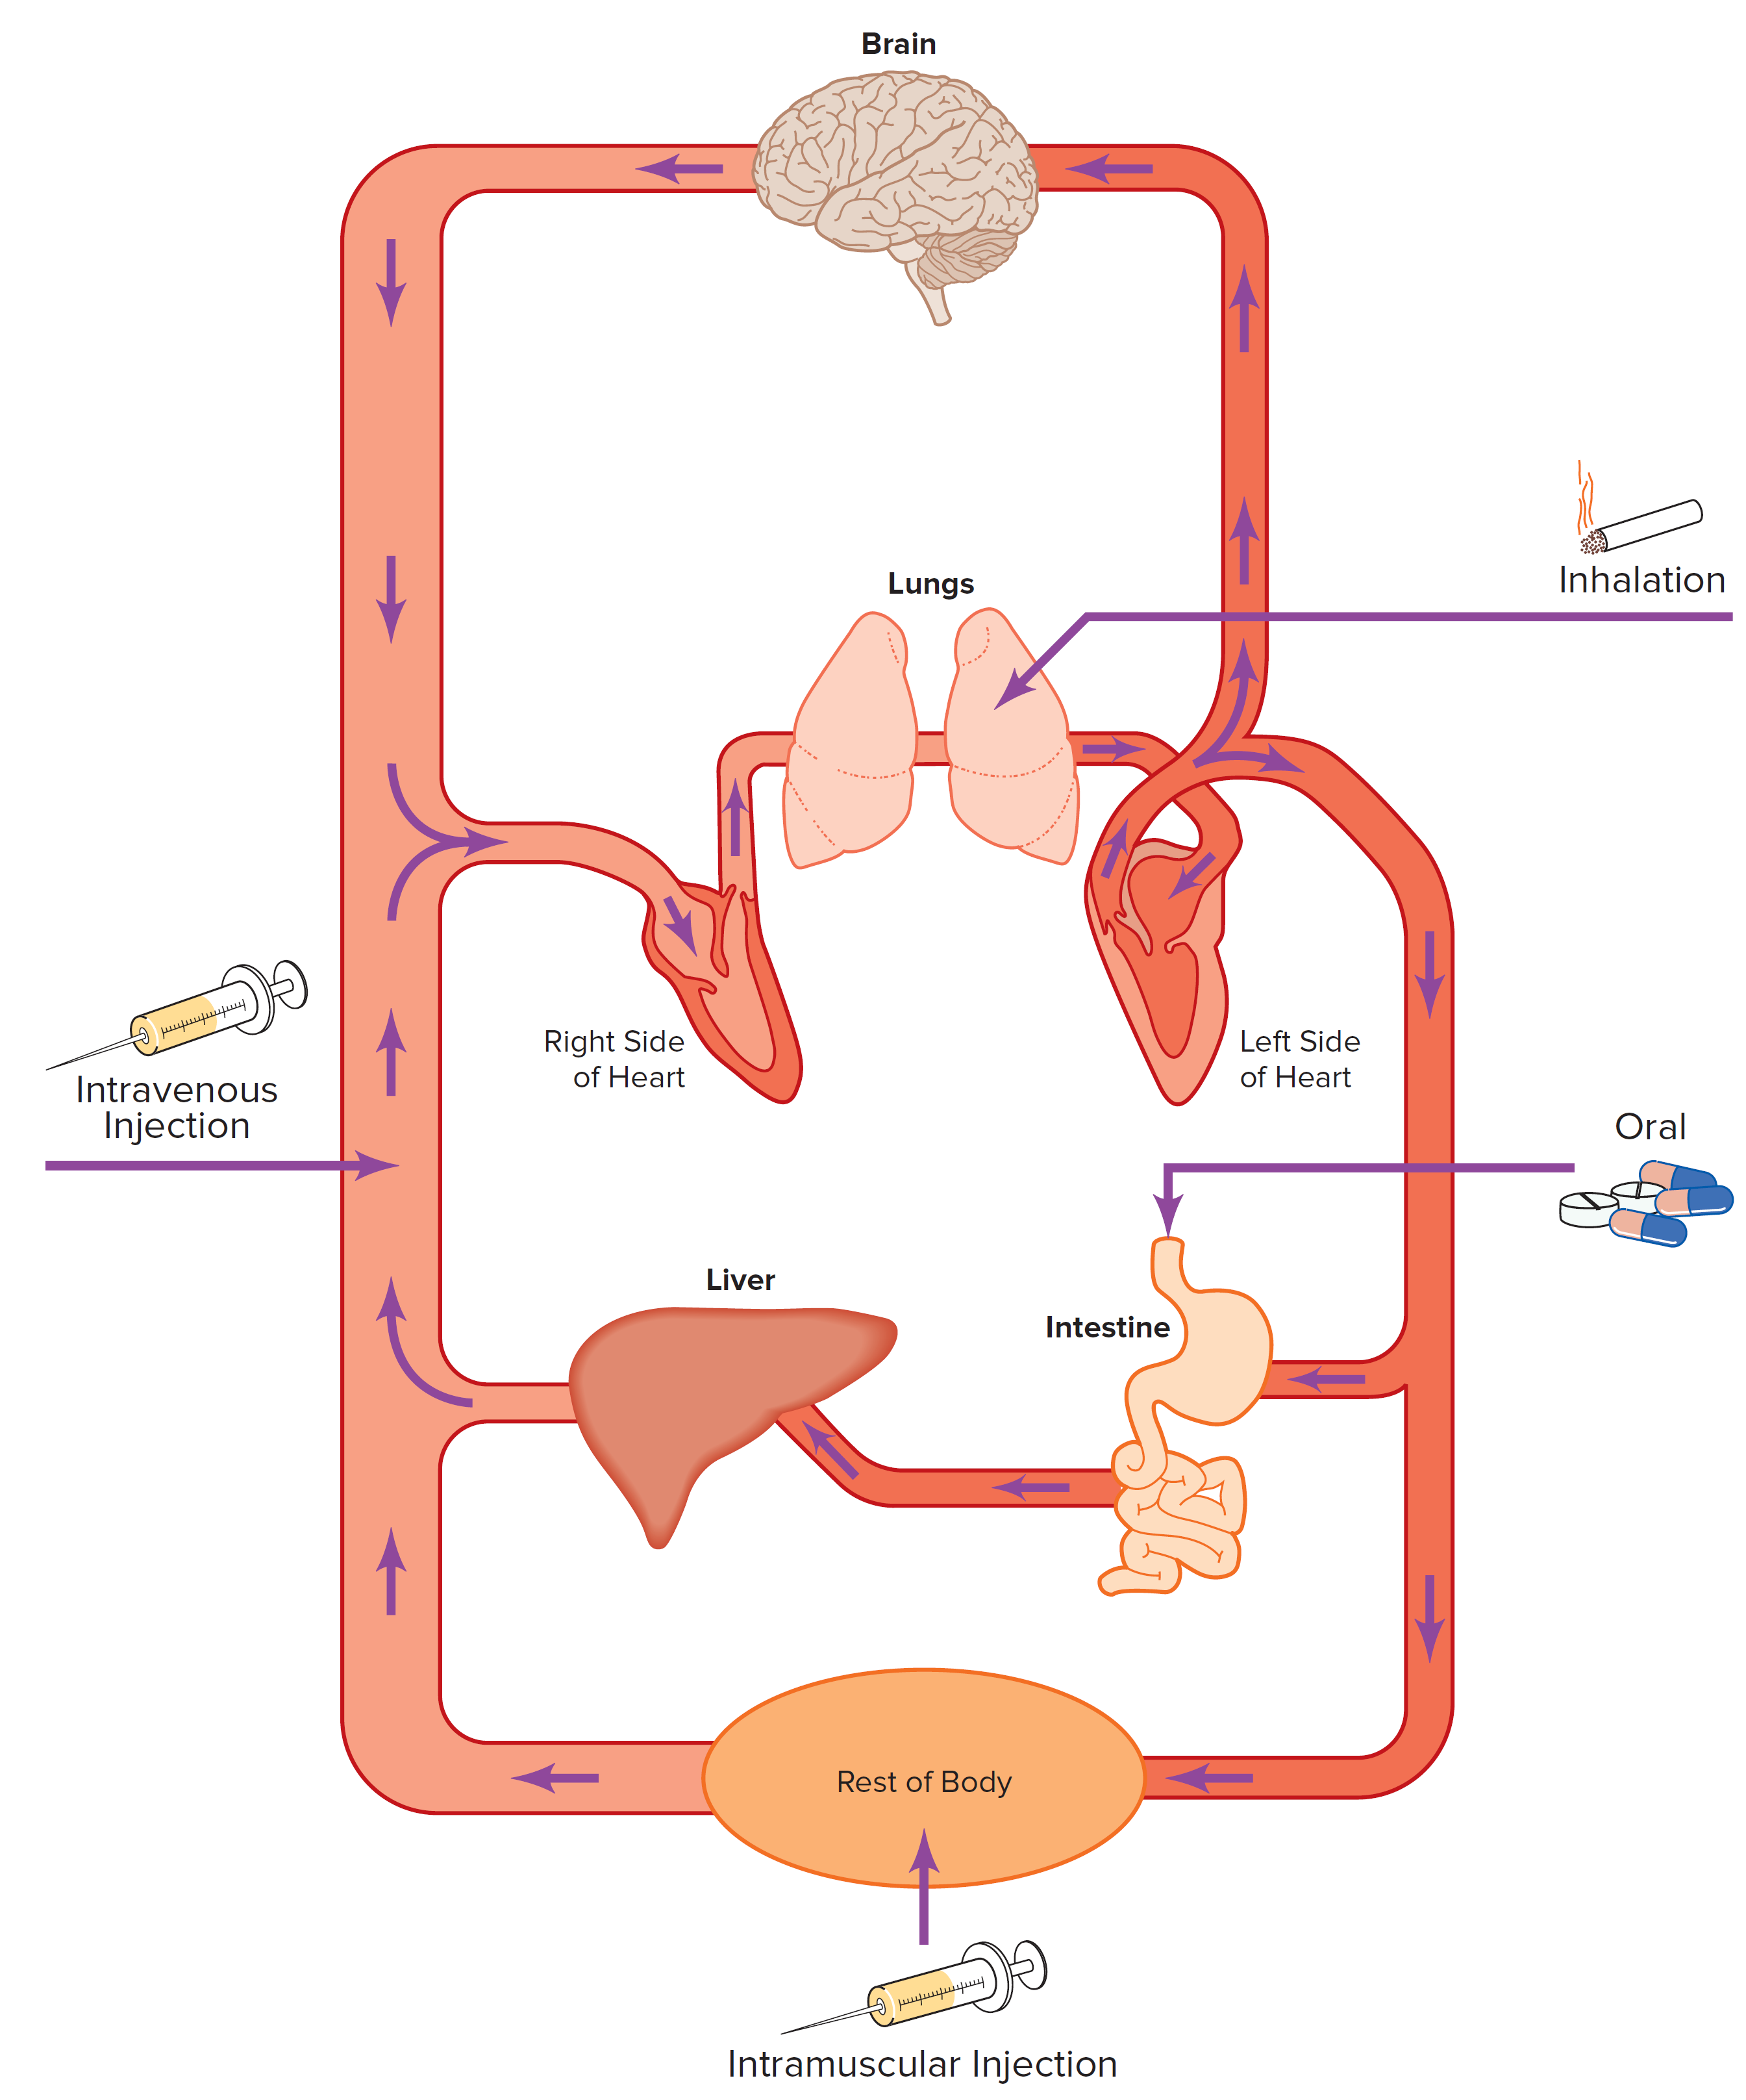
Routes of Administration
Administration route is a critical factor in how quickly a drug is absorbed.
Most common routes:
1) Injection (3x types)
2) Oral administration
3) Inhalation
Other common routes:
4) Intranasal
5) Sublingual
6) Transdermal

Slide 39
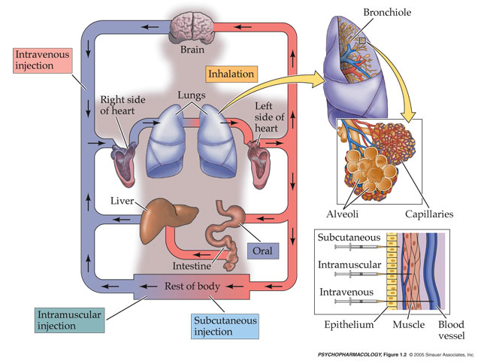
Injection
3 types:
1) intravenous (i.v.) injection
2) intramuscular (i.m.) injection
3) subcutaneous (s.c.) injection

Slide 40
1) Intravenous Injection
Intravenous Injection - Drug is delivered directly into the bloodstream.
Irritating material may be injected this way, because blood vessel walls are relatively insensitive
Doesn’t have to dissolve across capillaries
Pros.
High concentrations can be delivered.
Results in a rapid onset of its effects than does with oral administration or with other means of injection.
Cons/Risks.
Veins may become damaged over time.
Blood-borne diseases (HIV, hepatitis) spread easily.

Slide 41
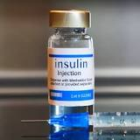
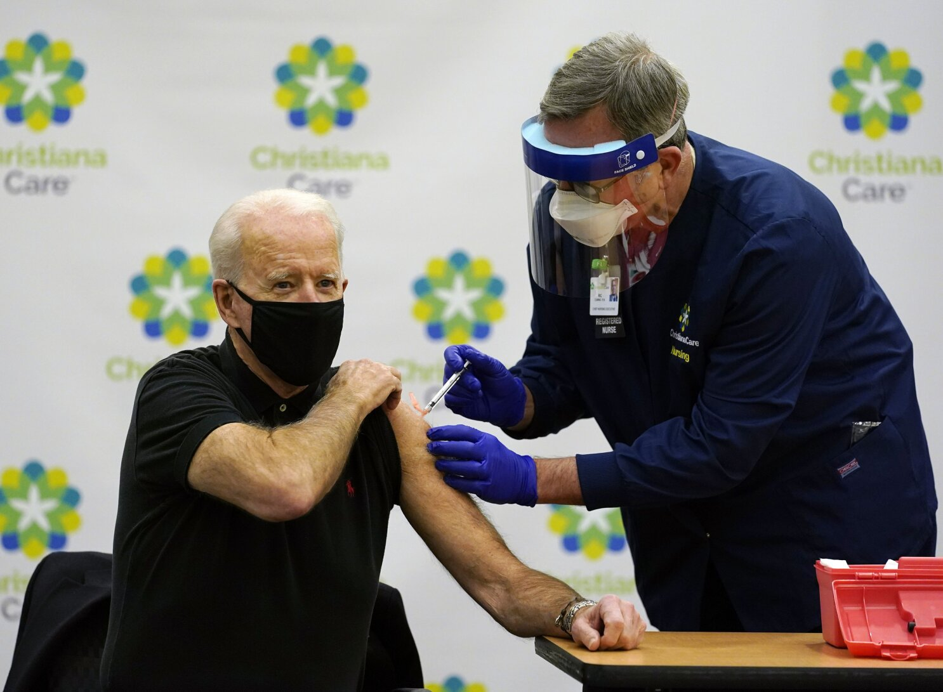
2-3) Subcutaneous and Intramuscular Injections
Subcutaneous injection.
Injection under the skin, good for hormone/lipophilic drugs.
Potential for pain and necrosis from irritating substances around the site of injection
Intramuscular injection.
Absorption is more rapid from intramuscular injection than from subcutaneous injection because of the greater blood supply in muscles.
most rapid when the injection is into the deltoid muscle of the arm and least rapid when the injection is in the buttock.
Drug absorption can be unpredictable or unusual in very obese and emaciated individuals

Slide 42
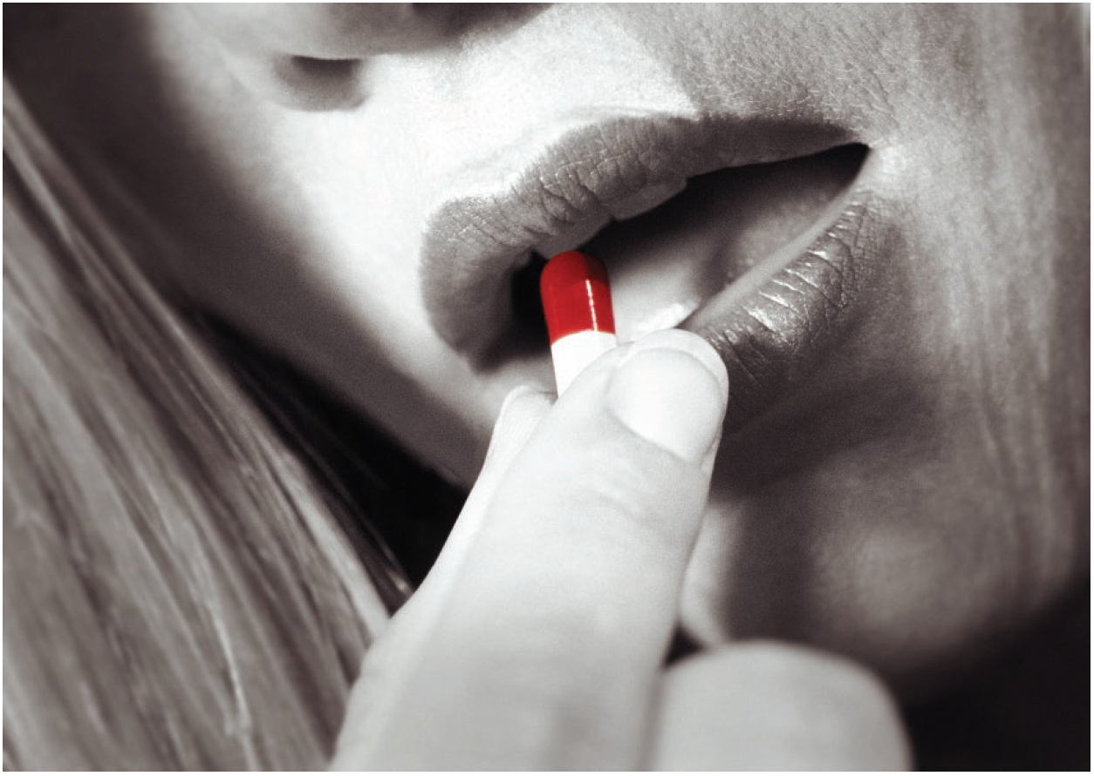
Oral Administration
Easiest for humans, but the gastrointestinal tract is the most complicated way to enter the bloodstream:
Drugs must withstand digestive processes and not be deactivated by food in the stomach before they are absorbed.
Rate of absorption depends on what else is in stomach
Drugs must then pass through the cells lining the gastro-intestinal tract and into the blood capillaries
First-pass Metabolism - then drugs pass through the liver.
Oral is only route where blood goes to liver first, which breaks down some drug, before going to general blood circulation
*** Very little may get into circulation if the drug gets metabolized rapidly...
Notes:
Prodrugs - Inactive in original form and become active only when altered by liver enzymes.

Slide 43
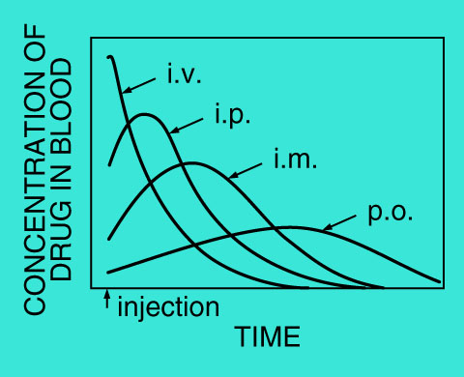
pharmacokinetics
Time courses for i.v., i.m., and p.o. routes (p.o. = “per oral” = by mouth = swallowing)
Notes:
Drug effects can be prolonged by taking additional doses at specific time intervals.
Intervals vary from one drug to another.

Slide 44
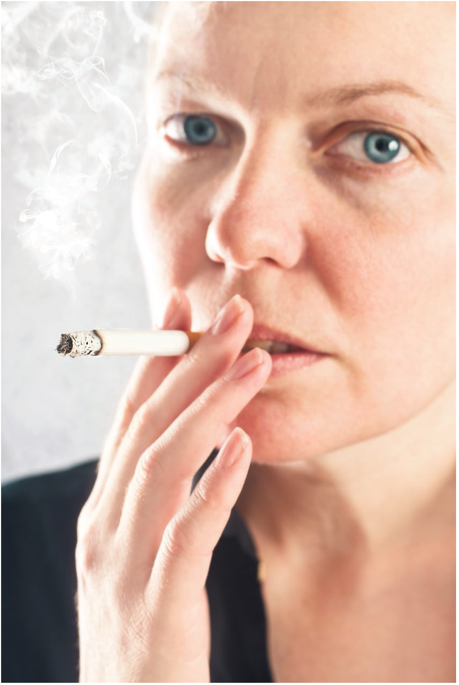
Inhalation
Aka, smoking.
FASTEST, highly efficient way of delivering a drug.
Onset of drug effects is rapid because the capillary walls are accessible in the lungs, and the drug thus enters the blood quickly.
Produces more rapid effects for psychoactive drugs than intravenous administration.
Blood from the lungs, which contains the drug, moves directly to the brain.

Slide 45
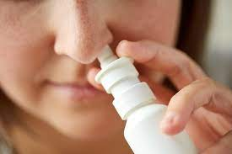
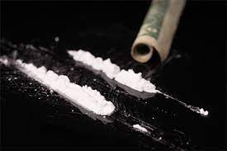
Intranasal/Insufflation
Also called… Insufflation (aka “snorting”)
Onset of effects is faster than it is for oral administration.
Absorption through mucous membranes into the bloodstream occurs rapidly, bypassing the liver.
Not as fast as i.v. or inhalation
Drawback associated with intranasal drug use includes nasal necrosis, or death of cells in the septal region.

Slide 46
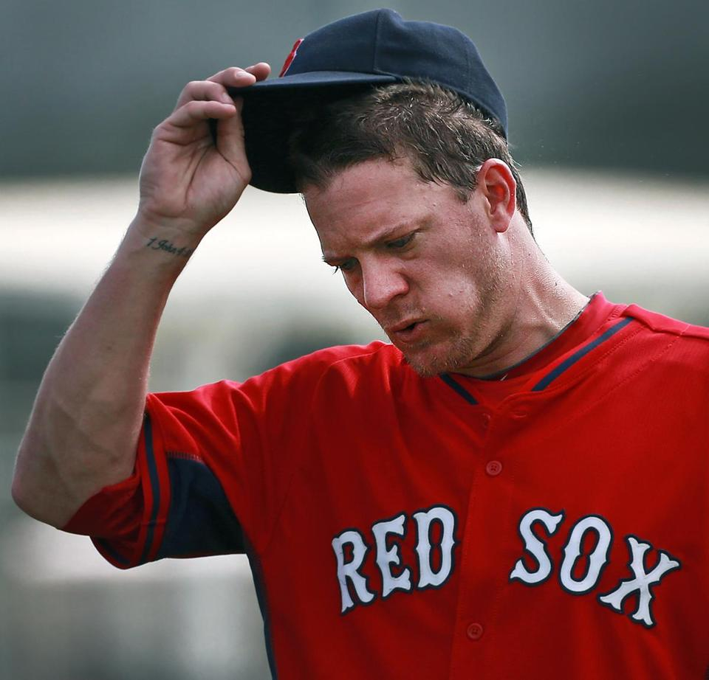
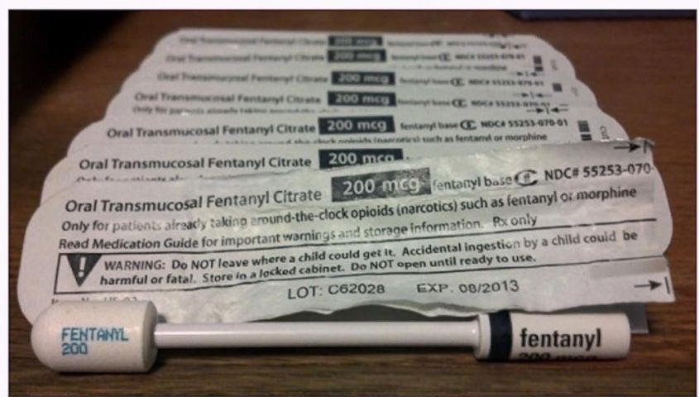
Sublingual
Buccal/transmucosal/sublingual
The drug is placed under the tongue.
Don’t actually swallow the substance
After dissolving through mucous membranes in mouth it is absorbed directly into the bloodstream.
Results in a rapid onset of drug effects, comparable to that which is observed after intranasal dosing.
Notes:
In order to avoid the destruction of drugs in the intestinal tract, drugs can be taken sublingual or anally.

Slide 47
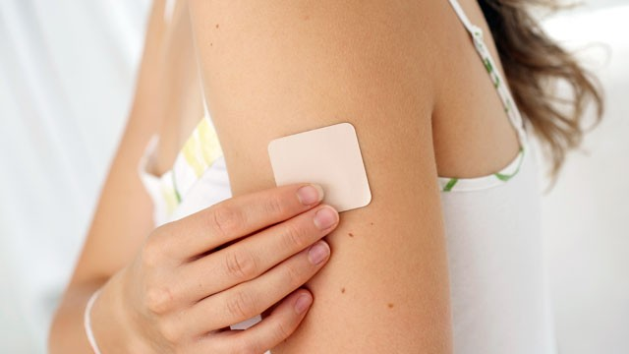
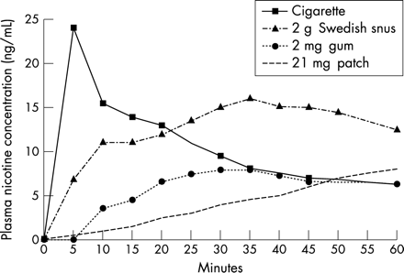
transdermal
Drugs are delivered across the skin to enter the bloodstream
Can be a patch, cream, gel, or spray
Patches typical for drugs that aim for slow and continuous delivery - drug will be delivered as long as the patch is worn
Pros:
Convenient - Most patches can just be adhered to the skin
Non-invasive
Cons:
Not all drugs can be absorbed through the skin
Some patches cause irritation
Blood levels of nicotine still rising for transdermal, when blood levels are falling for other routes

Slide 48
Table 5.1: Some Characteristics of Routes of Drug Administration
Route | Advantages | Disadvantages
Oral | Usually more safe Convenient | Absorption rate can be unpredictable Slow onset of drug effects
Intranasal | Liver metabolism avoided Rapid drug effects Reliable and convenient | Potential for nasal necrosis
Intravenous injection | Liver metabolism avoided Rapid drug effects | Increased risk of adverse effects: Direct (for example, overdose) and indirect (for example, potential for blood-borne diseases) Potential for collapsed veins
Notes:
Just summary table from your book, note that they don’t mention transdermal but you should know it

Slide 49
Table 5.1: Some Characteristics of Routes of Drug Administration 2
Route | Advantages | Disadvantages
Subcutaneous injection | Drug absorption can be slow and constant providing a sustained drug effect | Potential for pain and necrosis from irritating substances
Intramuscular injection | Drug effects are more rapid than subcutaneous route | Drug absorption can be unpredictable or unusual in very obese and emaciated individuals
Smoked (Inhalation) | Liver metabolism avoided Rapid drug effects | Increased risk of direct adverse effects Potential for lung toxicity
Sublingual | Liver metabolism avoided Rapid drug effects Reliable and convenient | Some drug formulations don’t work using this route (for example, extended-release formulations)

Slide 50
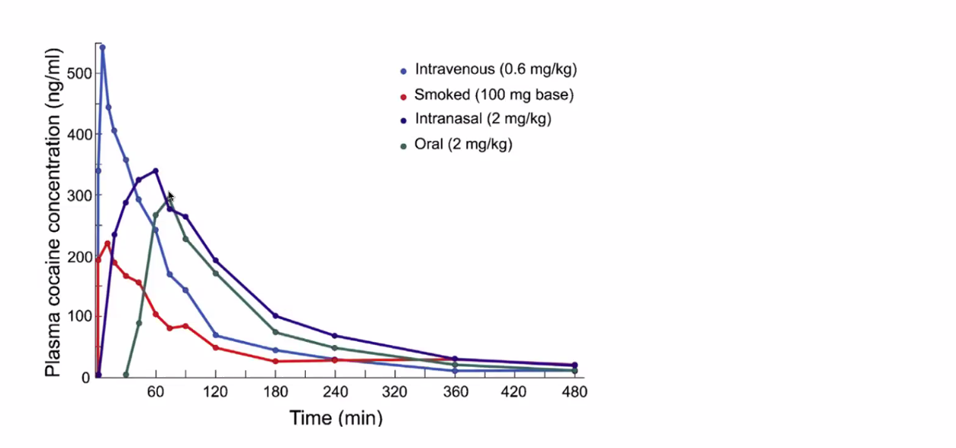
Route of administration is a crucial factor in drug reward
Faster drug injections results in:
increased limbic activity, more self admin, faster rise in dopamine neurotransmitter levels

Slide 51
DISTRIBUTION

Slide 52
How do drugs move from the blood to brain?
Drugs need to move into the Body → Blood → Brain
Blood transport: once in the bloodstream, drug molecules attach to protein molecules.
Most common protein involved is albumin.
Inactive in this state and cannot leave the blood.
Protected from inactivation by enzymes.

Slide 53
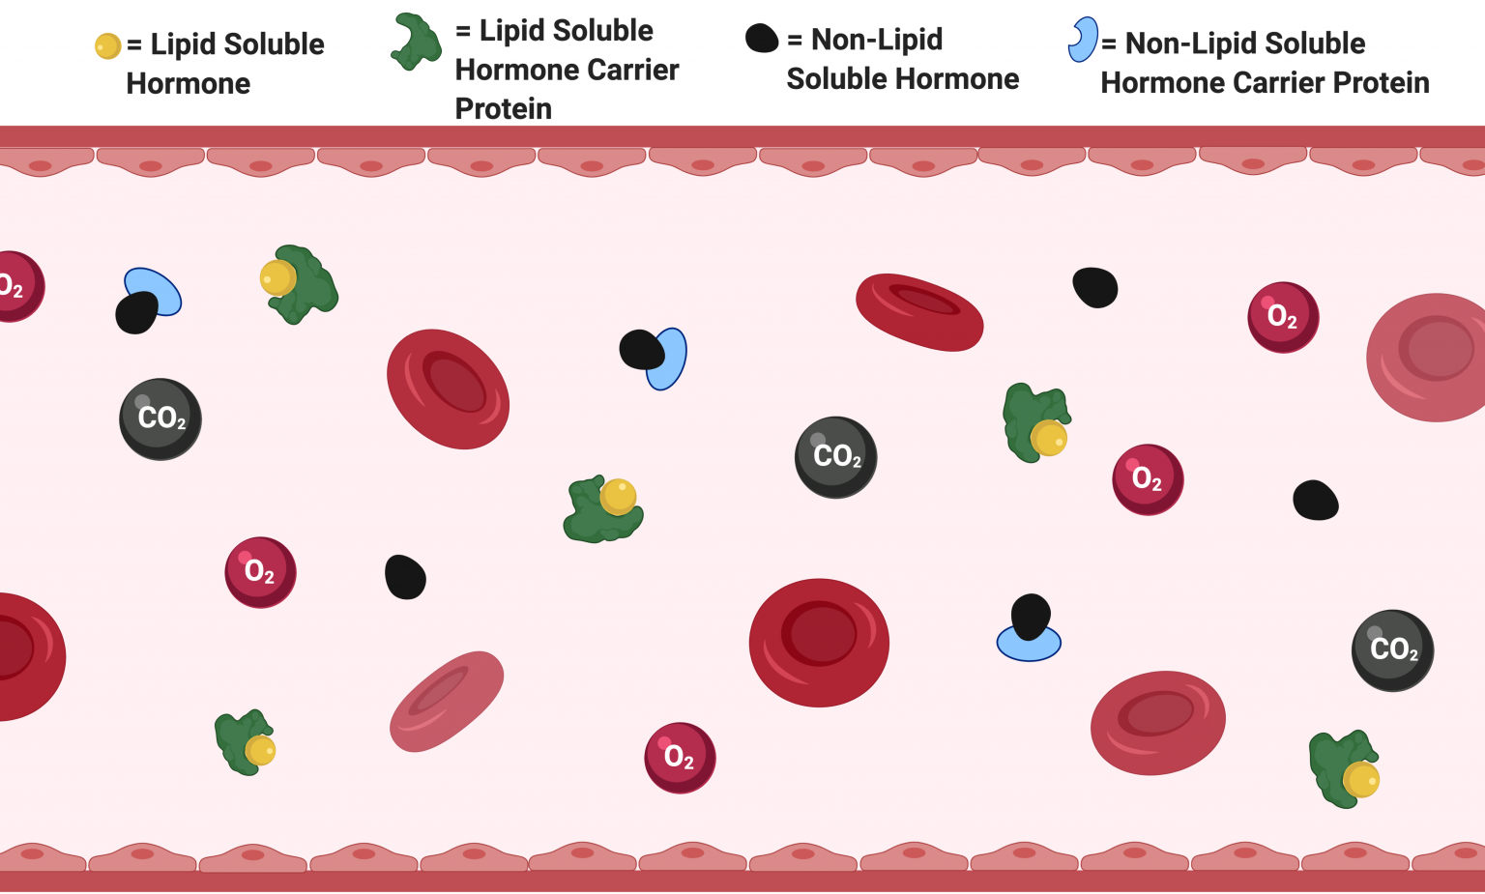
Transport in the Blood
Drugs vary in their affinity for binding with plasma proteins.
A drug with high affinity will displace a drug with low affinity, and thus, the drug with low affinity exists in the unbound form.
Increase in the unbound drug concentration helps move the drug out of the bloodstream to the sites of action faster.
Free, or unbound, drug molecules can move to sites of action in the body.
Release of protein-bound drug occurs to maintain the proportion of bound to free molecules.

Slide 54
How do drugs move from the blood to brain?
Drugs need to move from outside the Body → Blood → Brain
Once in the bloodstream, drug molecules attach to protein molecules.
However, still 2 factors to overcome –
1) Drug depots
2) Blood-brain barrier

Slide 55
Drug depots
Drug depots act to slow down pharmacokinetics
Inactive storage spots in the body effecting a drugs’ distribution and elimination
Blood proteins (e.g., albumin) can bind to (“stick to”) drug, temporarily
When bound, drug can’t cross blood-brain barrier
Typically occurs in fat, occasionally muscle, sometimes bone:
Some drugs (e.g., THC) dissolve into body fat, temporarily
Notes:
THC binds strongly to blood proteins, slowing its time course

Slide 56
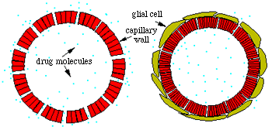
Blood-Brain Barrier (BBB)
In general, only small lipophilic molecules enter the brain.
About 85 percent of brain capillaries are covered with astrocytes, and there is little extracellular space next to the blood vessel walls.
Active transport systems may be needed to move chemicals in and out of the brain.
BBB also does not cover area of the brain – tends to be absent in hypothalamus and medulla in the “area postrema” (vomiting the center of the brain)
A capillary in body, outside of brain
A capillary in the brain

Slide 57
METABOLISM /
ELIMINATION

Slide 58
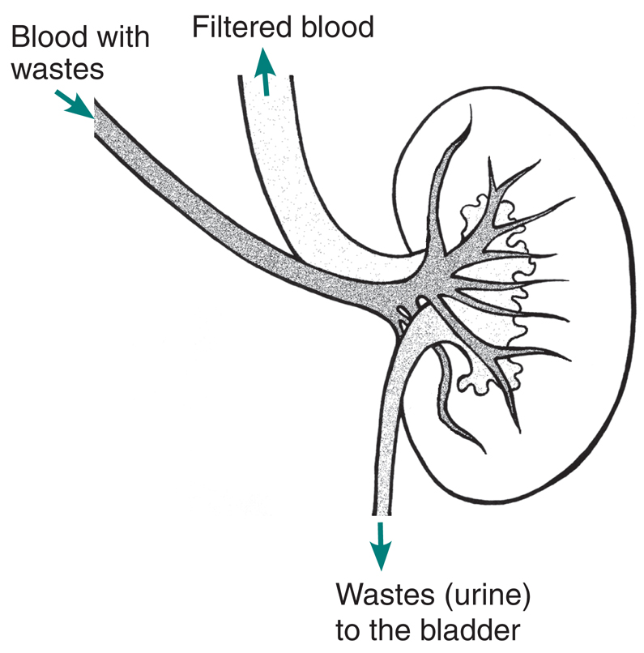
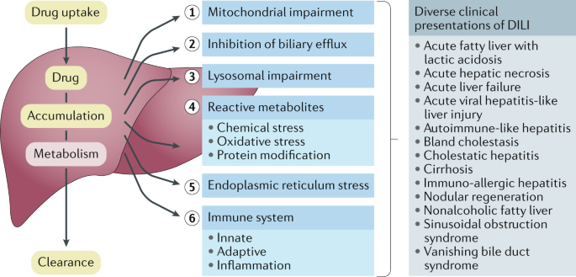
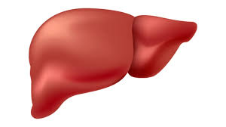
Metabolism
3. Elimination (Drug Deactivation)
A drug ceases to have an effect when it is either 1) chemically changed or is 2) excreted unchanged from the body.
Enzymes in the liver
Kidneys filter blood

Slide 59
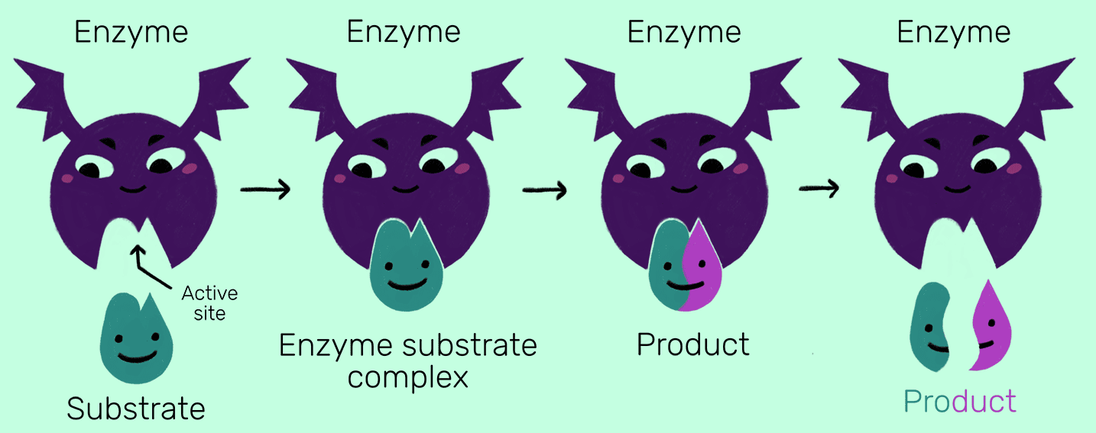
Liver function and Cytochrome p450
CYP450 – a family of liver enzymes specialized for inactivating various general kinds of foreign chemicals ingested.
Turn drugs into less lipid-soluble (i.e., more water-soluble) molecules called metabolites.
Many drugs have active metabolites that produce effects similar to those of the original drug and prolong the effects considerably.

Slide 60
Drug Deactivation
Liver (CYP450 enzymes)
Drug (lipid soluble) in blood
Metabolite
(more water soluble)
Drug (lipid soluble)
Kidneys
Lipid-soluble stuff
(Drug)
Reabsorbed in bloodstream
Water-soluble stuff
(metabolites)
excreted in urine

Slide 61
Drug half life and first order kinetics
Half-life: time needed for ½ of amount of drug in body to be eliminated.
Typical Drug Half Lives:
Cocaine = 1 hour
Morphine = 2 hours
Nicotine = 2-3 hours
Caffeine = 3 hours
Marijuana = 19 hours
PCP = 20+ hours
Notes:
Rates of metabolism

Slide 62
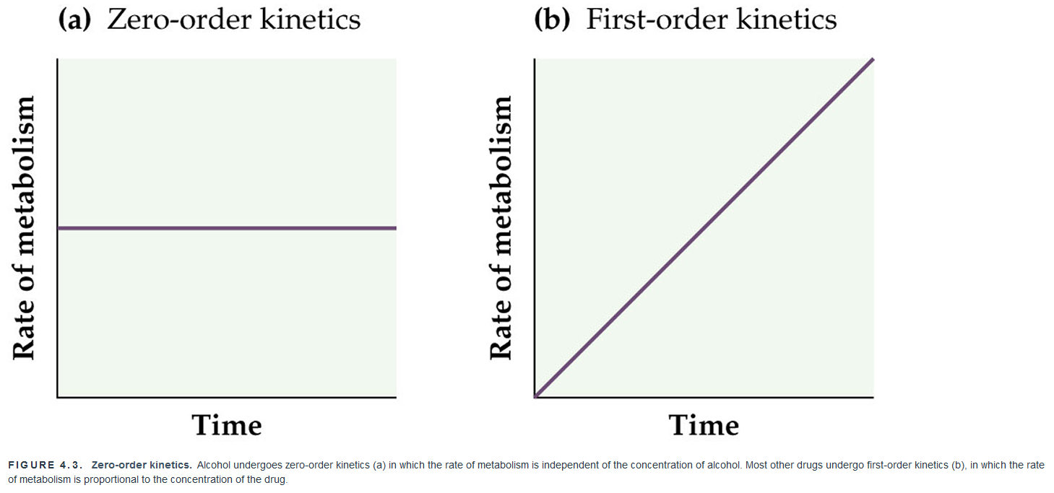
Drug half life and first order kinetics
First-order kinetics: Constant proportion of drug eliminated from body per unit time (most drugs eliminated this way)

Slide 63
Other factors determining the behavioral impact of drugs
How does pharmacokinetics play into pharmacodynamics?
1) Drug Interactions
2) Tolerance

Slide 64
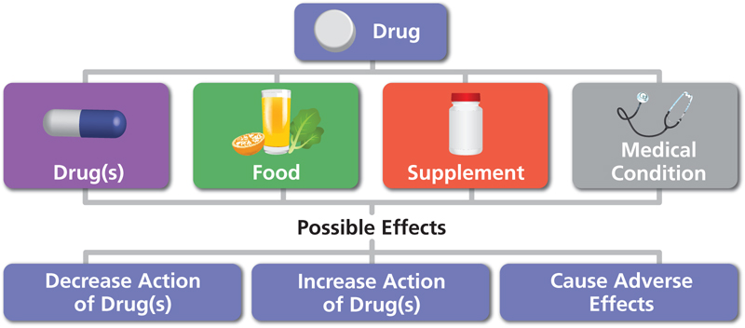
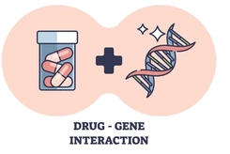
1) Drug Interactions
Additionally, taking multiple doses of drugs too close together will increase the maximum blood level with each dose, which can result in cumulative effects.

Slide 65
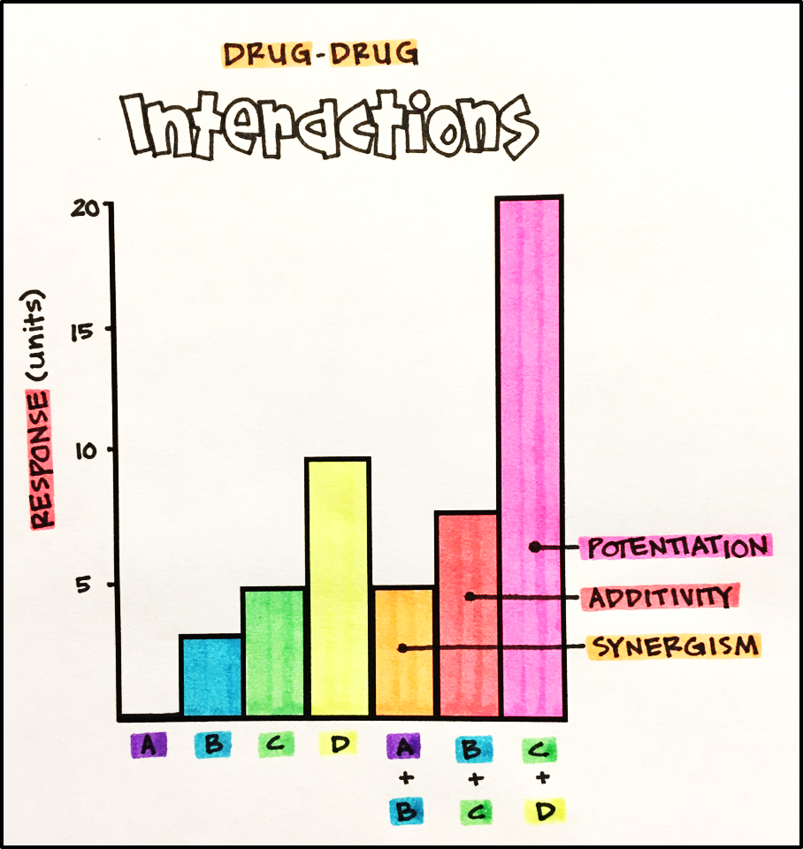
Drug-Drug Interactions
Effects may vary depending on whether you are looking at drugs in a similar (e.g., depressant drugs and alcohol) or opposite category (e.g., stimulant drugs like methamphetamine and with depressants like alcohol)
Additivity
Synergism
Potentiation
Antagonistic **
SYNERGISM
POTENTIATION

Slide 66
Possible Mechanisms of Drug Tolerance
1) Drug Disposition Tolerance (Metabolic)
aka “Pharmacokinetic Tolerance”, due to enzyme induction
2) Behavior Tolerance (Behavioral)
Learning to adjust behavior to compensate for drug effects
3) Pharmacodynamic Tolerance (Cellular)
Neurons adapt to long-term drug exposure

Slide 67
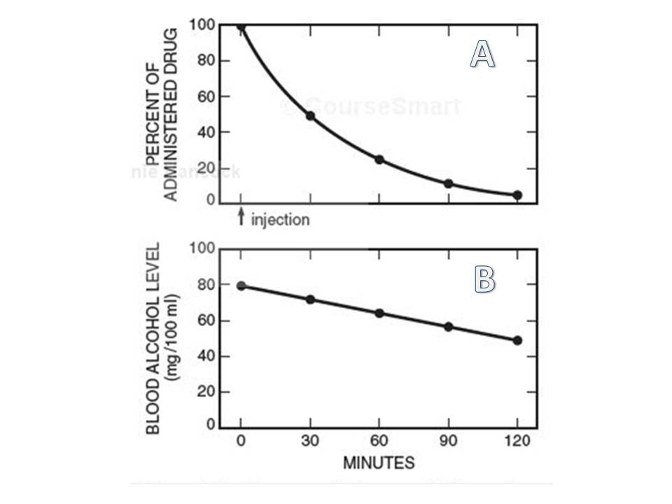
Metabolic Tolerance
Drug disposition, or pharmacokinetic/metabolic, tolerance.
Increased metabolism or excretion may reduce or alter the effect of the subsequent dose.
May relate to enzyme activity or the alteration of the pH of the urine.

Slide 68

Behavioural Tolerance
Behavioral tolerance.
Drug continues to have the same biochemical effect but with a reduced effect on behavior.
Reduced behavioral effect is a result of a drug user learning to compensate.

Slide 69
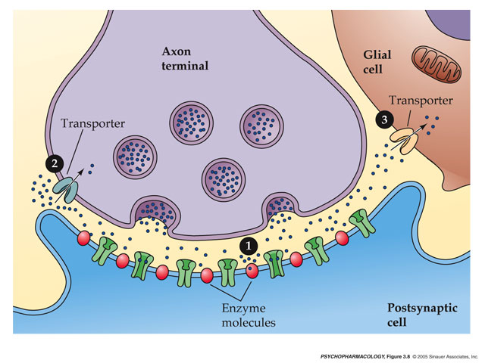
Cellular Tolerance
Pharmacodynamic tolerance.
Leads to a reduced effectiveness of the drug.
Neurons adapt to long-term drug exposure
Causes withdrawal symptoms.
How might a neuron with overstimulated receptors adapt to this overstimulation? What about understimulation? →
Notes:
Opponent-process theory applies here.

Slide 70
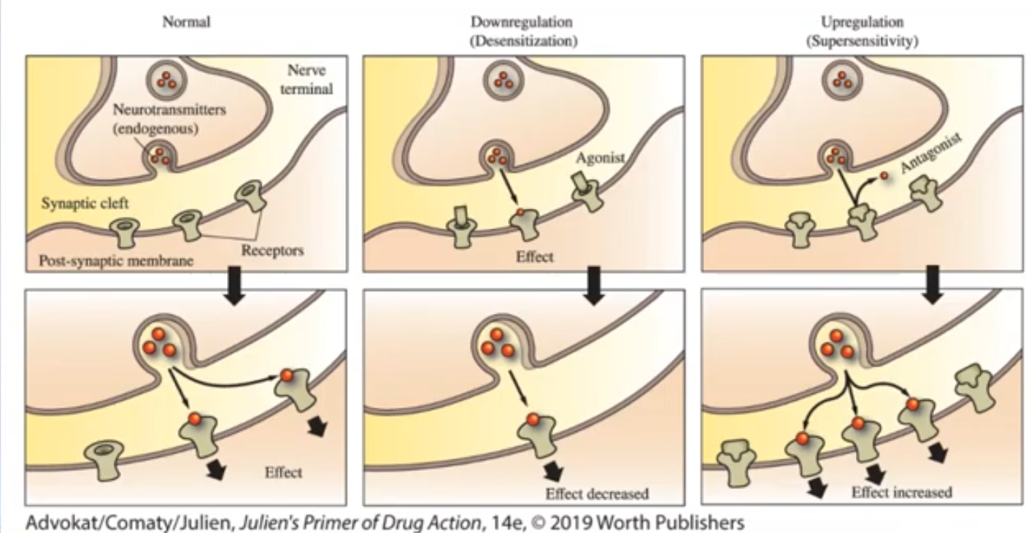
Pharmacodynamic and Behavioral Tolerance
Down-regulation: decreased number of receptors in response to overstimulation (desensitization)
Up-regulation: increased number of receptors in response to understimulation (hyper- or super- sensitivity)

Slide 71
Bringing it all together - Mechanisms of Drug Action
Today we’ve reviewed both:
Pharmacodynamics – the mechanisms by which a drug exerts its effects on the body
Pharmacokinetics – how the body handles drugs (absorption, distribution, metabolism/elimination)
https://www.youtube.com/watch?v=IOqCxGINGPs
Notes:
Don’t flip these around. ☺
ADME

